Slide 1
07
MACHINE LEARNING WITH SCIKIT-LEARN
Unsupervised Learning
+ Hyperparameter Tuning
Find structure nobody labeled — clusters, compressed views — then squeeze your best model with Grid & Randomized search.
Instructor: Shutchon Premchaisawatt
Master's Degree Program · Hands-on with Google Colab

Slide 2
AGENDA
Today's agenda
01
Unsupervised: no labels
what can we still learn?
05
DBSCAN
density, noise, weird shapes
02
KMeans
centroids & the assign-update loop
06
PCA
compress 13 features → 2D picture
03
Choosing k
elbow & silhouette
07
Grid & Randomized search
tuning without self-deception
04
Blind experiment
wine: rediscover 3 cultivars
08
Learning curves
more data or more model?
Machine Learning with scikit-learn
SESSION 07 · 3

Slide 3
NEW WORLD
What if nobody gives you y?
Clustering
Group similar rows.
Customer segments · patient phenotypes ·
document topics
→ KMeans, DBSCAN
Dimensionality reduction
Compress many columns into few.
Visualize 13-D data · de-noise ·
speed up downstream models
→ PCA
Anomaly detection
Find the weird ones.
Fraud probes · sensor faults ·
DBSCAN noise points
(comes free with clustering)
No score without y — evaluation becomes:
internal (silhouette) · stability · human judgment · proxy tasks
Machine Learning with scikit-learn
SESSION 07 · 4

Slide 4
CLUSTERING
KMeans: plant flags, regroup, repeat
1
① pick k centroids
random start
2
② assign
each point → nearest centroid
3
③ update
centroid → mean of its group
4
④ repeat ②③
until stable
→
→
→
from sklearn.cluster import KMeans
km = KMeans(n_clusters=3, n_init=10, random_state=42)
labels = km.fit_predict(X_scaled) # X has NO y
Assumes
round-ish, similar-size clusters.
Struggles on moons, rings, unequal blobs.
n_init=10 = retry 10 starts, keep best (sklearn ≥1.4 default).
inertia_ = total squared distance to centroids (lower = tighter) · labels_ = cluster id per row (0,1,2…)
Scaling FIRST — distances again (S03!)
Machine Learning with scikit-learn
SESSION 07 · 5

Slide 5
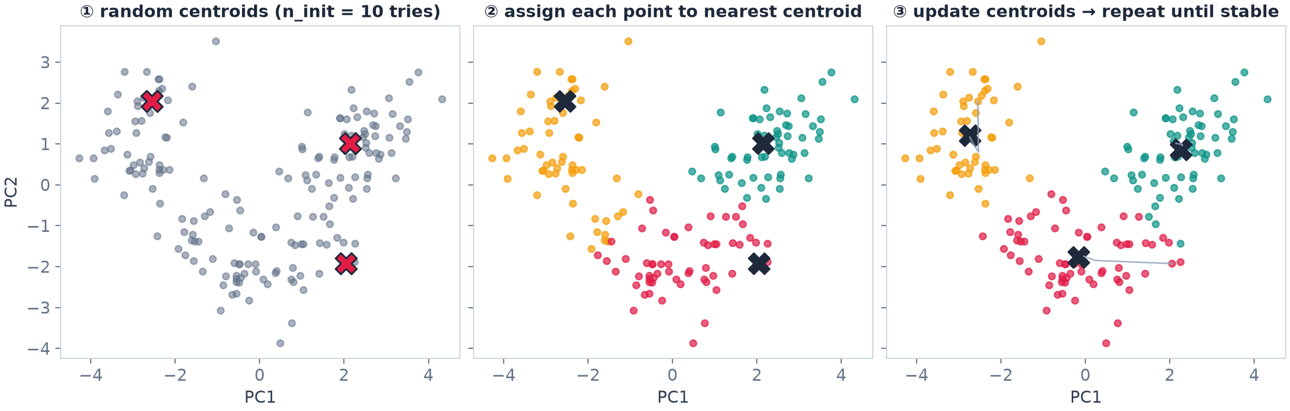
CLUSTERING
KMeans in pictures — assign & update
Real fit on wine (PCA-2D view): random centroids → assign every point to its nearest → move each centroid to its group's mean → repeat until stable
Always converges — but only to a LOCAL optimum. That's exactly why n_init=10 retries ten different starts and keeps the best.
Machine Learning with scikit-learn
SESSION 07 · 6

Slide 6
CHOOSING K
Elbow & silhouette (wine, 13 features, scaled)
Elbow: inertia always falls — look for the bend (≈3)
Silhouette = cohesion vs separation, −1…1; peaks at k=3 (0.285)
Both are guides, not verdicts — finally a HUMAN judges if segments make business sense
Machine Learning with scikit-learn
SESSION 07 · 7

Slide 7
★ THE REVEAL
Wine: KMeans found the 3 cultivars — blind
178 Italian wines · 13 chemical features · labels (3 cultivars) HIDDEN from the algorithm
98.3%
0.90
65/51/62
cluster sizes found
(truth: 59/71/48)
agreement with the hidden
cultivar labels (best mapping)
adjusted Rand index
(chance-corrected match)
Structure was IN the chemistry. No teacher, no labels — KMeans recovered the taxonomy.
That's what "unsupervised" buys you.
Machine Learning with scikit-learn
SESSION 07 · 8

Slide 8
AFTER CLUSTERING
Clusters are only useful if you can NAME them
df["cluster"] = labels
# how big is each segment?
df["cluster"].value_counts().sort_index()
# profile each cluster on original features
df.groupby("cluster").mean().round(1)
# the segment-naming moment:
df.groupby("cluster")[["alcohol", "flavanoids"]].mean()
# export the segments for the business team
df.to_csv("wine_segments.csv", index=False)
The analyst's job
read the profiles → invent names:
"low-alcohol/high-phenol group" …
For business data this is where money is made
"Segment 2: high income, low spending → target them"
  Anomaly bonus: rows far from any centroid = unusual
Machine Learning with scikit-learn
SESSION 07 · 9

Slide 9
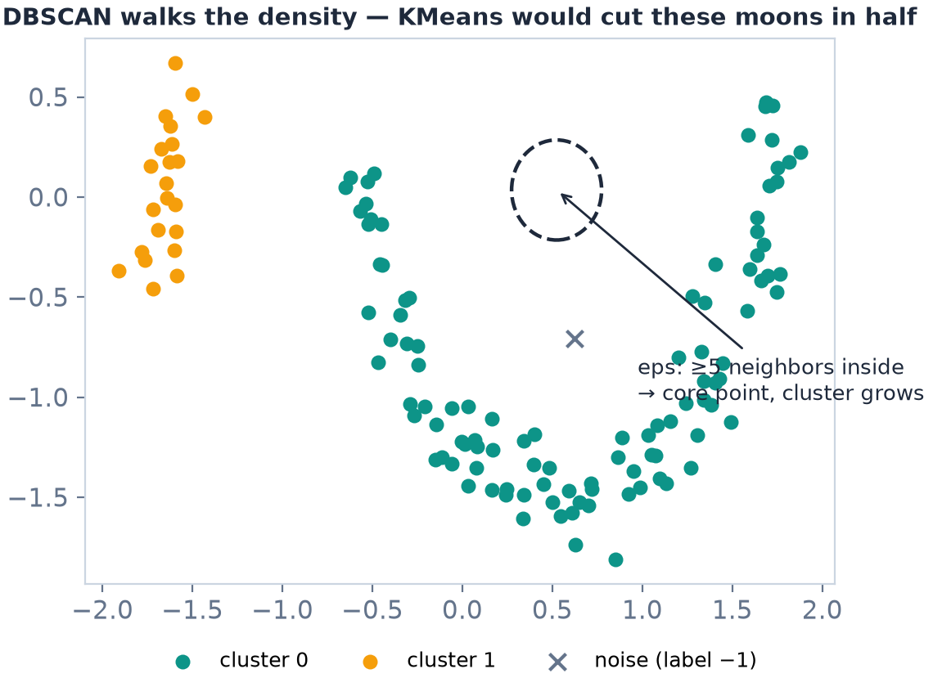
CLUSTERING #2
DBSCAN: follow the density, flag the weird
How it works
a cluster = region dense enough (min_samples within eps)
no k to guess — density decides
Superpowers
arbitrary shapes · automatic outlier flagging (label −1)
Knobs: eps, min_samples — sensitive; use a k-distance plot
KMeans = round blobs, fast, scalable · DBSCAN = shapes + noise, fussier
Machine Learning with scikit-learn
SESSION 07 · 10

Slide 10
COMPRESSION
PCA: 13 features → 2 axes that matter most
Idea
find the directions where the data varies most
keep the top few, drop the rest
Wine result (scaled):
PC1 explains 36.2% · PC2 19.2%
2 axes = 55.4% of 13 columns' story
10 of 13 needed for 95% — real data is spread out
Uses
plot 13-D data as a 2-D scatter (next slide)
de-noise / speed up pipelines
Always scale first — PCA hunts VARIANCE, and fare… er, proline has the biggest raw scale
Machine Learning with scikit-learn
SESSION 07 · 11

Slide 11
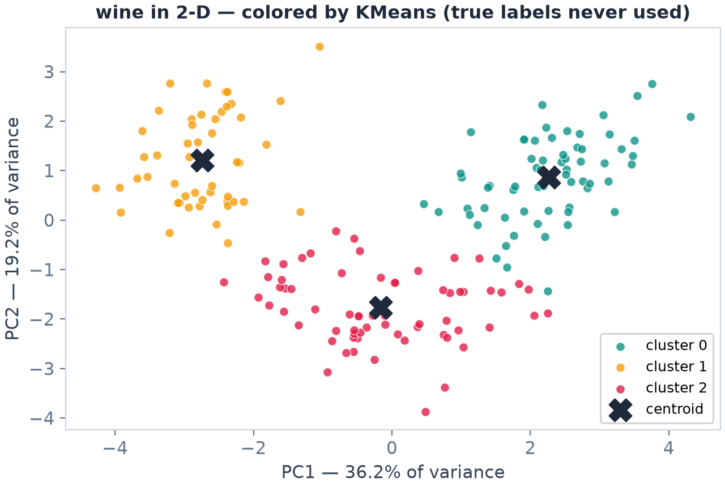
THE PICTURE
PCA 2-D scatter: clusters you can SEE
Z = PCA(n_components=2).fit_transform(X_scaled)
sns.scatterplot(x=Z[:,0], y=Z[:,1], hue=labels)
3 clouds = 3 cultivars, visible
plot colored by cluster OR by true label — same picture (ARI 0.90!)
This chart is also your unsupervised sanity check
Machine Learning with scikit-learn
SESSION 07 · 12

Slide 12
PART 2
Now squeeze: hyperparameter tuning
model | hyperparameters (knobs) | who sets them
KNN | n_neighbors, weights | YOU — before fit()
DecisionTree | max_depth, min_samples_leaf | YOU
RandomForest | n_estimators, max_features, … | YOU
Ridge / Lasso | alpha | YOU
DBSCAN | eps, min_samples | YOU
Linear regression | (none — parameters w, b are learned) | the data
Defaults are good, not optimal. Tuning = search knobs with CV — never with the test set.
Machine Learning with scikit-learn
SESSION 07 · 13

Slide 13
TUNING
GridSearchCV: try every cell of the grid
trees=100
trees=300
It's the S04 protocol, automated
every candidate judged by the same CV
best_score_ = CV score of the winner
  Re-fit on ALL training data happens automatically
max_depth=depth=None
max_depth=6
max_depth=4
2 × 3 = 6 candidates × 5 CV folds = 30 fits — sklearn runs them all
gs = GridSearchCV(model, {"n_estimators": [100, 300],
"max_depth": [None, 6, 4]}, cv=5)
gs.fit(X_train, y_train) # best_params_, best_score_ inside
Machine Learning with scikit-learn
SESSION 07 · 14

Slide 14
TUNING
RandomizedSearchCV: when the grid explodes
Grid pain
6 hyperparameters × 5 values each = 15,625 combos × 5 folds
Random fix
sample n_iter=30 random points from DISTRIBUTIONS
n_estimators: randint(50, 500) — any integer, not a fixed list
30 good guesses ≈ 15,625 exhaustive ones — usually
from scipy.stats import randint
rs = RandomizedSearchCV(
RandomForestClassifier(random_state=42),
{"n_estimators": randint(50, 500),
"max_depth": [None, 4, 6, 8, 12],
"min_samples_leaf": [1, 2, 4],
"max_features": ["sqrt", "log2", None]},
n_iter=30, cv=5, random_state=42)
best CV 0.965: depth 8 · log2 · 97 trees · leaf 1
Machine Learning with scikit-learn
SESSION 07 · 15

Slide 15
HONESTY CHECK
Tuning worked… then didn't (and that's informative)
RandomForest (breast cancer) | CV | test
default knobs | — | 0.958
after RandomizedSearch (30×5) | 0.965 | 0.958
Reflex to avoid
Tuning until the TEST number finally rises = tuning on the test set. Soft leakage (S04).
CV improved (+0.7pt), test didn't move
this dataset is near its ceiling — the signal separates cleanly
Tuning pays big when: the search space is rich · defaults are far off · the problem is harder (S08 churn!)
The PROCESS is still correct — report both numbers honestly
Beyond today
HalvingRandomSearchCV — successive halving, smarter budget on big data.
Machine Learning with scikit-learn
SESSION 07 · 16

Slide 16
DIAGNOSIS
Learning curves: more data or more model?
Read it
CV climbs 0.73 → 0.96 as rows grow: DATA was the bottleneck
train pinned at 1.0: RF memorizes any training set
Converging curves ≈ plateau — more rows won't help much now
learning_curve(model, X, y, cv=5, train_sizes=…)
Machine Learning with scikit-learn
SESSION 07 · 17

Slide 17
DIAGNOSIS
Symptom → prescription
symptom | diagnosis | prescription
train ↑ / test ↓ (gap) | overfitting | more regularization, simpler model, more data, fewer features
both low, small gap | underfitting | richer model, more features, less regularization
CV unstable across folds | high variance | more data, simpler model, CV with more folds
CV ≫ test | tuned to CV / shift | trust test; simpler search; check leakage again
Machine Learning with scikit-learn
SESSION 07 · 18

Slide 18
SHIPPING
Save the winner — and the reproducibility kit
import joblib
joblib.dump(best_pipeline, "churn_model.joblib")
clf = joblib.load("churn_model.joblib") # anywhere
clf.predict(new_raw_rows) # transforms inside
Dump the PIPELINE, not just the model
preprocessor + model travel together
Reproducibility kit
random_state everywhere · library versions ·
the exact CV object · who ran what, when
S08 project deliverable = exactly this kit
Final pitfall checklist
split first · transform inside · WHEN known? · duplicates? · same folds for comparisons · right metric · Dummy anchor · test ONCE
Machine Learning with scikit-learn
SESSION 07 · 19

Slide 19
LAB 07 · DO IT IN GOOGLE COLAB
ค้นพบกลุ่มที่ซ่อนอยู่ + ปรับแต่งโมเดล — wine & tuning
YOUR MISSION (โจทย์ภาษาไทยใน Colab)
Learning goal
Unsupervised discovery on wine (elbow/silhouette, blind validation, PCA picture) plus a full tune of your best classifier.
โหลด wine (13 features) แล้ว scale — รัน KMeans k=2..8 เก็บ inertia และ silhouette — k เท่าไหร่ดีที่สุด?
เฉลย: เทียบ labels ที่ได้กับ y จริงด้วย adjusted_rand_score — คอมเมนต์ผล
วาด PCA 2 แกน ระบายสีด้วย cluster — เห็น 3 กลุ่มไหม อธิบาย explained variance
profile แต่ละ cluster ด้วย groupby().mean() แล้วตั้งชื่อกลุ่มเป็นภาษาไทย
ปรับแต่ง: RandomizedSearchCV บน RandomForest ของ breast cancer — เทียบ CV ก่อน/หลัง และ test ครั้งเดียว
Vibe coding corner
ลองถาม AI: “ช่วยออกแบบการทดลอง tune RandomForest ให้ครอบคลุมแต่ไม่แพงเกิน 30 fits” แล้วเช็กว่ามันเสนออะไรเกินจำเป็น/ผิดหลัก leakage ไหม
Machine Learning with scikit-learn
SESSION 07 · 20

Slide 20
KEY TAKEAWAYS
1. Unsupervised finds structure without labels — KMeans on wine recovered the 3 cultivars at 98% agreement.
2. Choose k with elbow + silhouette, then make clusters useful by NAMING them (profile → segment story).
3. DBSCAN for shapes + noise; PCA to compress & visualize (13 features → 2 axes = 55% of wine's story).
4. Tune with Grid/RandomizedSearchCV on CV — 30 random guesses often match a huge grid.
5. Honesty: CV 0.965 → test 0.958 happens; report both. Dump the whole pipeline with joblib.
NEXT
Session 08 — Final Project — Customer Churn Prediction, end to end
Machine Learning with scikit-learn
SESSION 07 · 21

